Slide 1

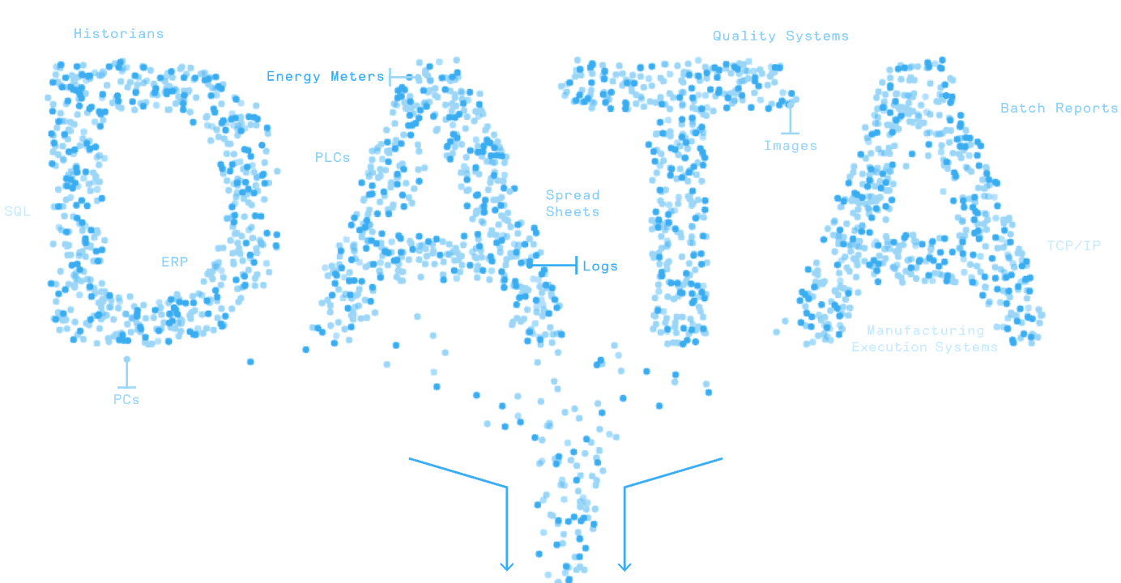


MATLAB 基础实验手册
第十章 面向对象编程
Dr Leo Chen
leo.chen@ieee.org
1

Slide 2
10. 1 实验
目标：创建类与对象
内容：创建 Student 类，包含学生姓名（name）和学校（school）两个属性，并能够显示学生信息；随后创建该类的对象进行测试。
创建类:
创建属性:
classdef Student
properties
name = "Jack";
school = "Suzhou No.1 Primary School";
end
methods
function obj = Student(name, school)
obj.name = name;
obj.school = school;
end
function info(obj)
disp("Name: " + obj.name);
disp("School: " + obj.school);
end
end
end
student1 = Student("Mary", "Shanghai Experimental Primary School");
student1.info;
结果：
Name: Mary
School: Shanghai Experimental Primary School

Slide 3
10. 2 实验
目标：使用继承创建子类
内容：以 Student 为父类，创建子类 CollegeStudent，新增专业（major）属性。
创建类:
创建属性:
classdef CollegeStudent<Student
properties
major
end
methods
function obj = CollegeStudent(name, school, major)
obj = obj@Student(name, school)
obj.major = major;
end
function info(obj)
info@Student(obj);
disp("Major: " + obj.major);
end
end
end
student2 = CollegeStudent("Mike", "Peking University", 'Math');
student2.info;
结果：
Name: Mike
School: Peking University
Major: Math

Slide 4
10. 3 实验
目标：设置类的访问控制
内容：将 Student 类中的 school 属性访问权限设为 protected，只允许自身及其子类访问。
创建类:
创建属性:
classdef Student
properties
name = "Jack";
end
properties (Access = protected)
school = "Suzhou No.1 Primary School";
end
… % the same with “10. 1 Lab” 。
student1 = Student("Mary", "Shanghai Experimental Primary School");
student1.info;
student1.name
student1.school
结果：
Name: Mary
School: Shanghai Experimental Primary School
ans = "Mary"
类 'Student' 没有公共属性 'school'。

Slide 5
10. 4 实验
目标：编写重载（重写）方法
内容：
在 Student 类中添加方法 getScoreLevel，根据成绩返回等级：Excellent、Good、Pass、Failed。
在 CollegeStudent 类中重写 getScoreLevel，等级改为 A、B、C、D、E。
getScoreLevel in Student ：
getScoreLevel in CollegeStudent ：
function level = getScoreLevel(~,score)
if score >= 85
level = "Excellent";
elseif score >= 75
level = "Good";
elseif score >= 60
level = "Pass";
else
level = "Failed";
end
end
function level = getScoreLevel(~,score)
if score >= 90
level = "A";
elseif score >= 80
level = "B";
elseif score >= 70
level = "C";
elseif score >= 60
level = "D";
else
level = "F";
end
end
运行结果：

Slide 6
10. 5 实验
目标：定义类的事件
内容：创建一个新类，在其中定义“时间改变”事件；监听该事件，一旦时间发生变化即显示当前时间。
Create Class:
Create Object:
classdef Clock < handle
properties
time = datetime("now");
end
events
TimeChange
end
methods
function change(obj, t)
if (obj.time ~= t)
obj.time = t;
notify(obj, 'TimeChange')
end
end
function showTime(obj, src, data)
disp(['时间：' + string(obj.time)])
end
end
end
c = Clock;
h1 = c.addlistener('TimeChange', @c.showTime); % Create a listener for the event.
c.change(datetime("now")); % Notify the listener that an event is occurring
c.change(datetime("2014-5-5")); % Time changed, display time
c.change(datetime("2014-5-5")); % The time is unchanged. The time is not displayed
delete(h1); % Delete listener
c.change(datetime("now")); % The time changes and the time is not displayed
时间：2024-04-06 13:31:57
时间：2014-05-05
Results：

